Slide 1
Convolutional Neural Networks

Slide 2
Neural Networks
Basic Neural Network
Is a family of techniques
Neural networks/multi-layer perceptron networks are good for data that can be represented well in a vector format
But not the best for all types of data

Slide 3
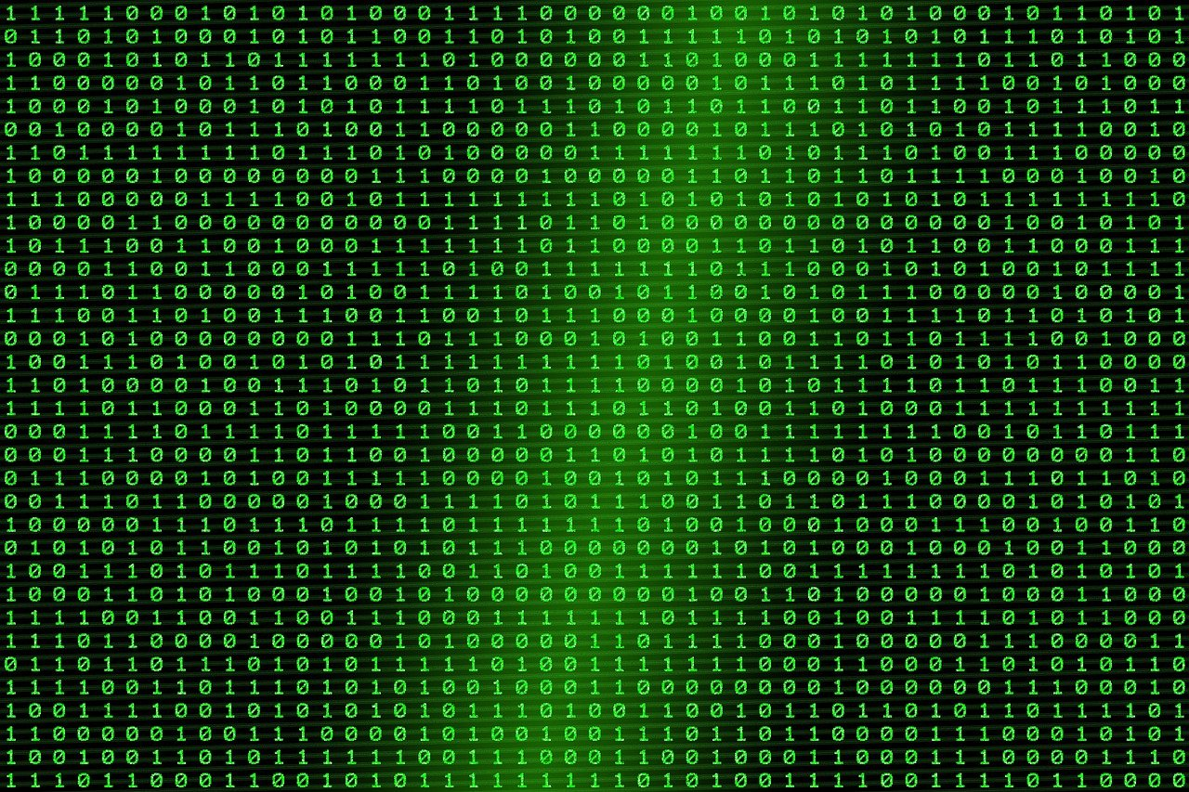
Image Data
What if we wanted to classify images?
Images are matrixes of pixel values
Could split them up into one long vector
But we would lose "area" information
Neighborhood values

Slide 4
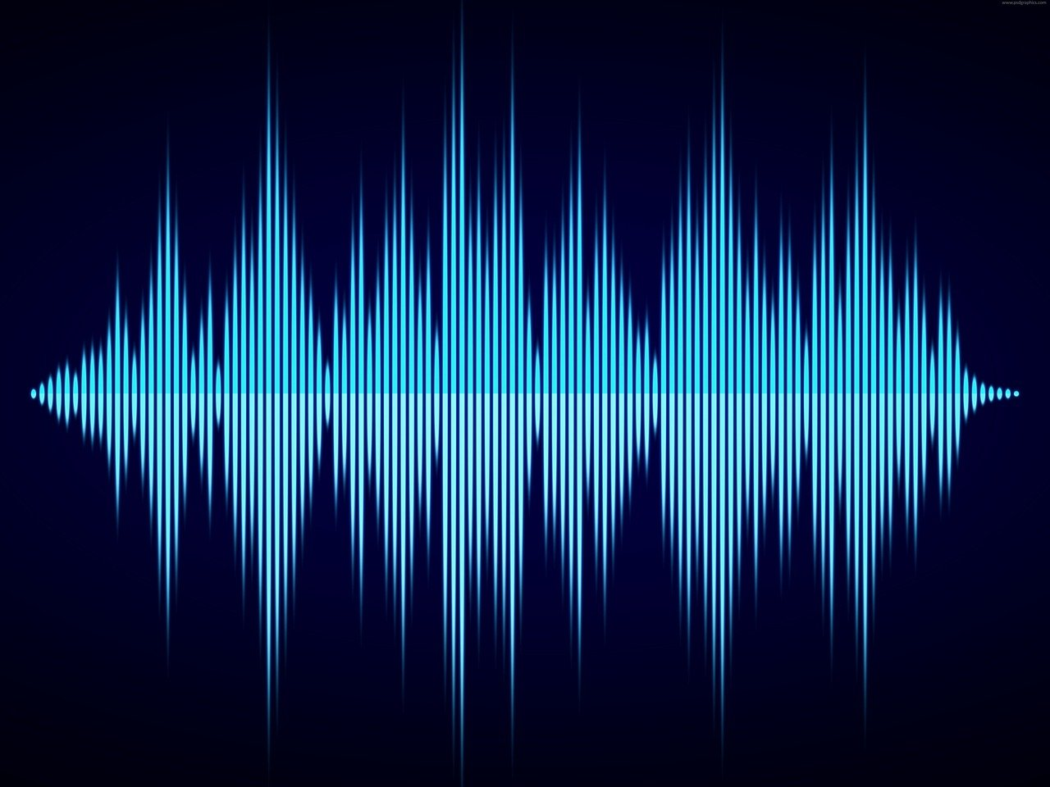
Solution – Convolutional Neural Networks
If these were dogs, they would be golden retrievers
Great for image data or data that can be represented as an image
Pictures
Waveform Audio

Slide 5
Convolution Operator
Let's pretend we have a very simple image (grayscale - between 0 and 255)

Slide 6
Convolution Operator
Let's pretend we have a very simple image (grayscale - between 0 and 255)
Represent as pixels
50
200
200
200
255
50
0
255
10

Slide 7
Convolution Operator
Now we create a Convolutional Filter
Represent as a smaller matrix
Also has values
0
2
50
200
200
1
0
200
255
50
0
255
10

Slide 8
Convolution
Not the same as convolution in signals processing
Reall cross-correlation
Put this filter on top of the image, sliding window, multiple pixels on top of each other and add together to get output.
0
2
50
200
200
1
0
200
255
50
0
255
10

Slide 9
Example
First sliding window
50
200
200
0
2
200
255
50
1
0
0
255
10
Image (and location of convolutional filter)
Convolutional
Filter
Math Operation
Output

Slide 10
Example
First sliding window
50*0 = 0
200*2 = 400
200*1 = 200
255*0 = 0
0+400+200+0 = 600
50
200
200
0
2
600
200
255
50
1
0
0
255
10
Image (and location of convolutional filter)
Convolutional
Filter
Math Operation
Output

Slide 11
Example
Second sliding window
200*0 = 0
200*2 = 400
255*1 = 255
50*0 = 0
0+400+255+0 = 655
50
200
200
0
2
600
655
200
255
50
1
0
0
255
10
Image (and location of convolutional filter)
Convolutional
Filter
Math Operation
Output

Slide 12
Example
Third sliding window
200*0 = 0
255*2 = 510
0*1 = 0
255*0 = 0
0+510+0+0 = 510
50
200
200
0
2
600
655
200
255
50
1
0
510
0
255
10
Image (and location of convolutional filter)
Convolutional
Filter
Math Operation
Output

Slide 13
Example
Fourth sliding window
255*0 = 0
50*2 = 100
255*1 = 255
10*0 = 0
0+100+0+255= 355
50
200
200
0
2
600
655
200
255
50
1
0
355
510
0
255
10
Image (and location of convolutional filter)
Convolutional
Filter
Math Operation
Output

Slide 14
Finished
Image - Convolutional Operator -> Smaller Output "Image"
Features Extracted -> "Convolved Feature"
50
200
200
655
0
2
600
200
255
50
355
1
0
510
0
255
10
Output
Image (and location of convolutional filter)
Convolutional
Filter

Slide 15
Convolutional Neural Network
Color images usually have three channel - RGB (Red, Green, Blue)
For color images you usually have one filter per channel

Slide 16

https://towardsdatascience.com/a-comprehensive-guide-to-convolutional-neural-networks-the-eli5-way-3bd2b1164a53

Slide 17

Padding
https://towardsdatascience.com/a-comprehensive-guide-to-convolutional-neural-networks-the-eli5-way-3bd2b1164a53

Slide 18
Pooling
Also sliding window (kernel)
Max pooling
Average Pooling
600
655
600
655
530
655
510
355
510
355
Average Pooling
Max Pooling

Slide 19
Convolutional Neural Networks
Normal neural networks – have weights and biases
Attached to neurons
In convolutional neural networks, have sets of filters rather than nodes
Filters grid values are the trainable weights
Convolution operation performs the weighted sum
Output put through activation afterward
Often pooling in between layers

Slide 20
Visually
Filter 1
0
2
1
0
"Net"
Output
Max Pooling
Filter 2
Activation
600
655
600
655
50
200
600
655
600
655
200
1
1
655
1
0
Convolution
600
1
510
355
510
355
510
355
510
355
200
255
50
1
0
510
355
1
0
0
255
10
Filter 3
1
1
Input
1
0

Slide 21
Convolutional Neural Network
Get smaller, "thicker" filter stacks
At the end, separate images into vectors and add fully connected classification network
Backprop works similarly – just have to figure out weights connections
Sometimes average update values across the filter in order to do backpropagation

Slide 22

https://towardsdatascience.com/a-comprehensive-guide-to-convolutional-neural-networks-the-eli5-way-3bd2b1164a53
Create an account here: https://app.cvat.ai/ ​
Download the zip file here: https://github.com/marzeverett/Coeur-Duck-Lene

Slide 23

https://towardsdatascience.com/a-comprehensive-guide-to-convolutional-neural-networks-the-eli5-way-3bd2b1164a53

Slide 24
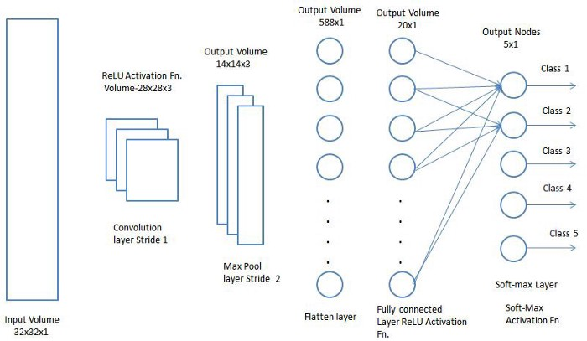
https://towardsdatascience.com/a-comprehensive-guide-to-convolutional-neural-networks-the-eli5-way-3bd2b1164a53
Create an account here: https://app.cvat.ai/ ​
Download the zip file here: https://github.com/marzeverett/Coeur-Duck-Lene

Slide 25
Convolutional Neural Networks
Very, very popular for a variety of tasks
There is a hierarchy for visual systems/machine vision
Once again, I recommend taking the machine vision class for a much more in-depth exploration

Slide 26
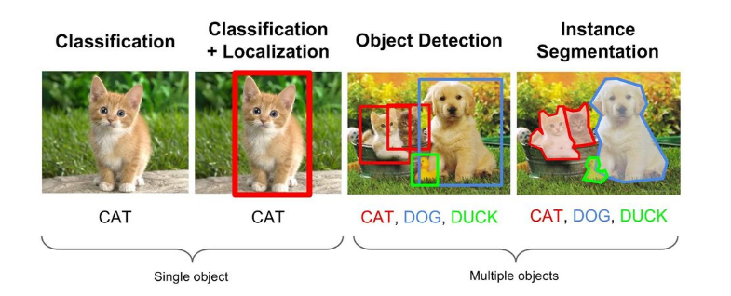
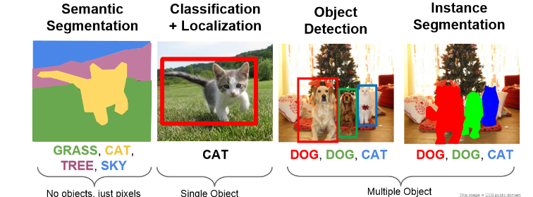
https://nanonets.com/blog/semantic-image-segmentation-2020/

Slide 27



Data Augmentation
Very popular for convolutional neural networks to expand datasets
Adjust cropping, rotation, scale, orientation, brightness, skew, etc.
Much more data – more robust networks
Cars on a one-way street

Slide 28
Ethics
Convolutional Neural Networks Can be VERY Biased
Lot of ethical concerns with
Representation in datasets
Who owns data used to train them
What they get used for/accuracy, explainability

Slide 29
Quick Mnist Convnet in Keras
Directly using the example here: https://keras.io/examples/vision/mnist_convnet/

